Slide 1
Modular Course B: Creative Design in shoe Industry
Unit B1 – Creative Design
Lecture LB1.5 – Biomimicry
T2.2 – Development of modular courses and training material.
D2.2 – Modular Course in Creative Design

Slide 2
Contents
What is biomimicry
How Use Biomimicry for inspiration
Worked Examples
Pitfalls of Biomimicry

Slide 3
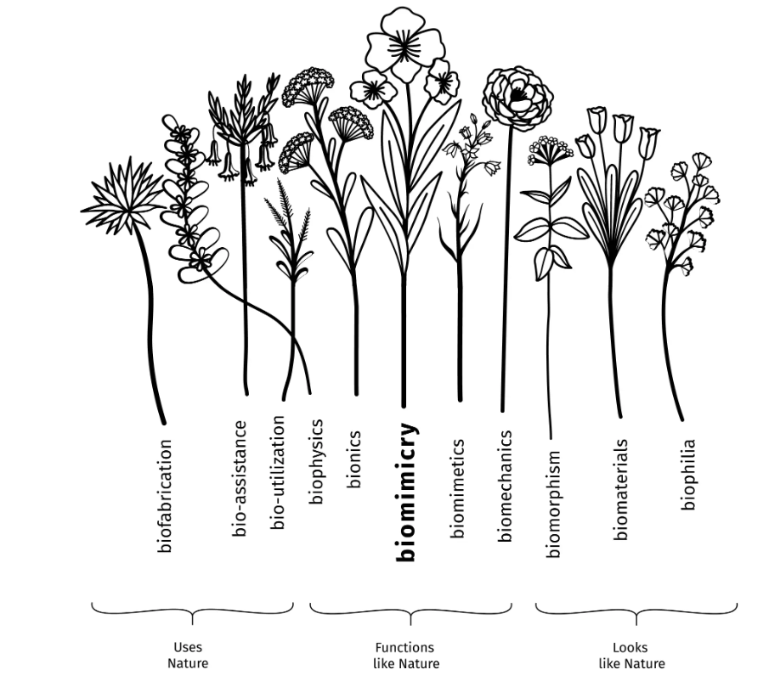
What is Biomimicry
Nature offers countless examples of evolutionary strategies at work fostering conditions conducive to life.
Ask “how might nature solve this problem?” for your design challenge.
Learn how biological systems can help inspire new solutions for your product or service that are inherently more circular and holistic
Notes:
“Biomimicry is about looking at nature for inspiration. We study how animals, plants, and ecosystems function, then use those insights to create products that are innovative, functional, and sustainable. The goal is to design solutions that work well while respecting natural systems.”

Slide 4
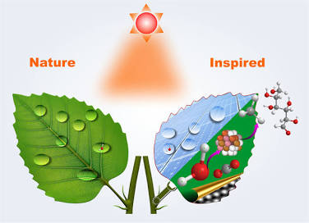
Learn from Nature
Biomimicry is the design of products and systems that are inspired by and modelled on existing biological processes, which have feedback built in.
Looking outside of your industry is a great way to inspire the development of your own ideas, and looking to nature is one way to do this.
Applies biological processes, structures, and patterns to product and system design by
Living systems have had 3.8 billion years of R&D.
Notes:
As Janine Benyus stated, “living systems have had 3.8 billion years of R&D.”

Slide 5
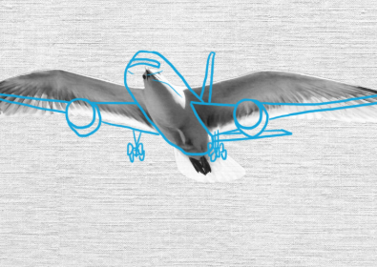
Why Biomimicry Matters in Design
Solves complex challenges by applying natural strategies
Supports sustainability – lowers waste, energy, and resource use
Drives innovation – new aesthetics, improved performance, fresh solutions
Footwear & leather relevance – inspires material innovation (bio-based leathers), comfort & performance (lightweight, flexible designs), and eco-design (sustainable production)
Notes:
“Biomimicry matters because nature has already solved many of the challenges we face today. By studying those solutions, we can address design problems more efficiently.”
“It also supports sustainability: natural strategies often minimize energy, waste, and material use — which is critical for the future of footwear and leather design.”
“At the same time, biomimicry drives innovation. It can inspire new looks, improve performance, and even change how we think about everyday products.”
“For footwear and leather, this means exploring bio-based materials like mycelium leather, self-cleaning coatings inspired by lotus leaves, or high-grip soles inspired by geckos

Slide 6
Nature-Inspired Design for Physical Products
Observe nature and copy its processes and strategies to solve complex design challenges.
How can nature solve this design problem?” → inspires innovative, holistic solutions. Analyze how animals and plants function, then integrate these insights into your designs.
Use feedback loops: test solutions, learn from results, and improve designs continuously.
Nature-inspired design promotes progressive, eco-friendly products.
Supports sustainability by reducing environmental impact and respecting natural systems.

Slide 7
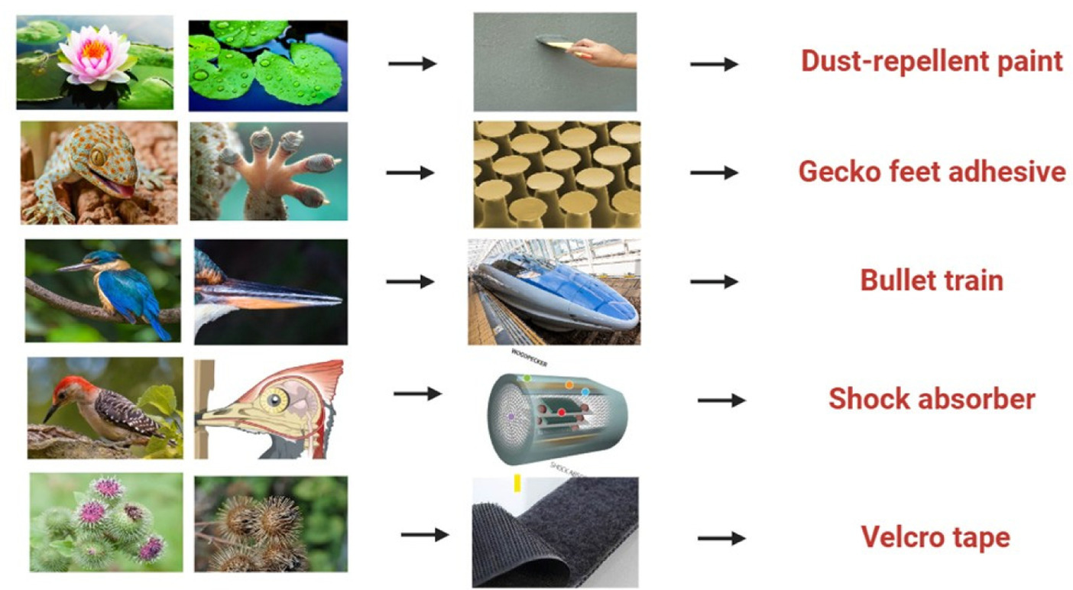
Biomimicry Examples
Image from Biomimicry at the nanoscale – A review of nanomaterials inspired by nature (Mundekkad & Mallya, 2025).

Slide 8
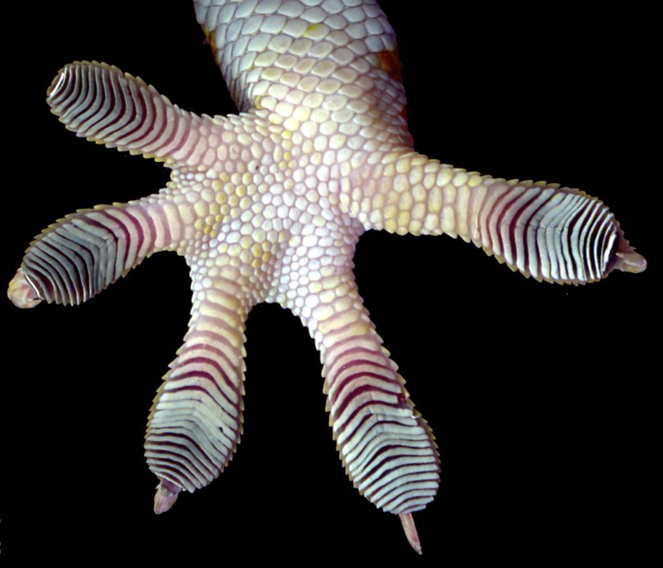
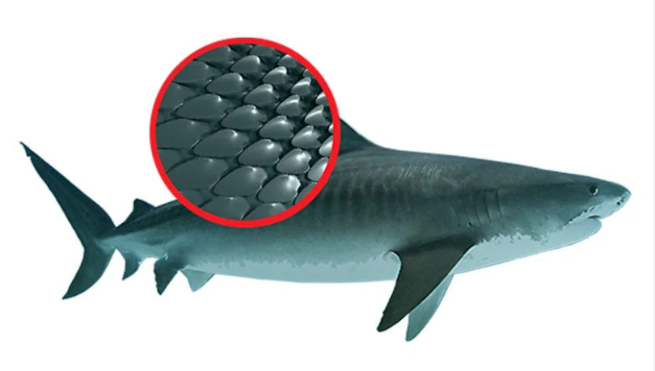
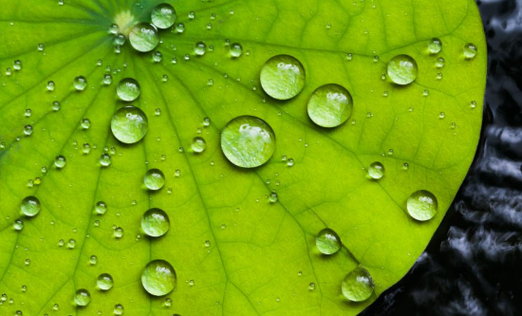
Learn from nature - Case Studies
Lotus Effect
  Key principle : Lotus leaf → hydrophobic surfaces
  Design Application: water-repellent sneaker uppers, leather coatings
Gecko Feet
Key principle : Micro-structures = adhesion
Design Application: high-grip soles, climbing shoes
Shark Skin
Key principle : Ribbed texture → antibacterial, reduces drag
Design Application: anti-bacterial shoe insoles, scratch-resistant leather textures

Slide 9
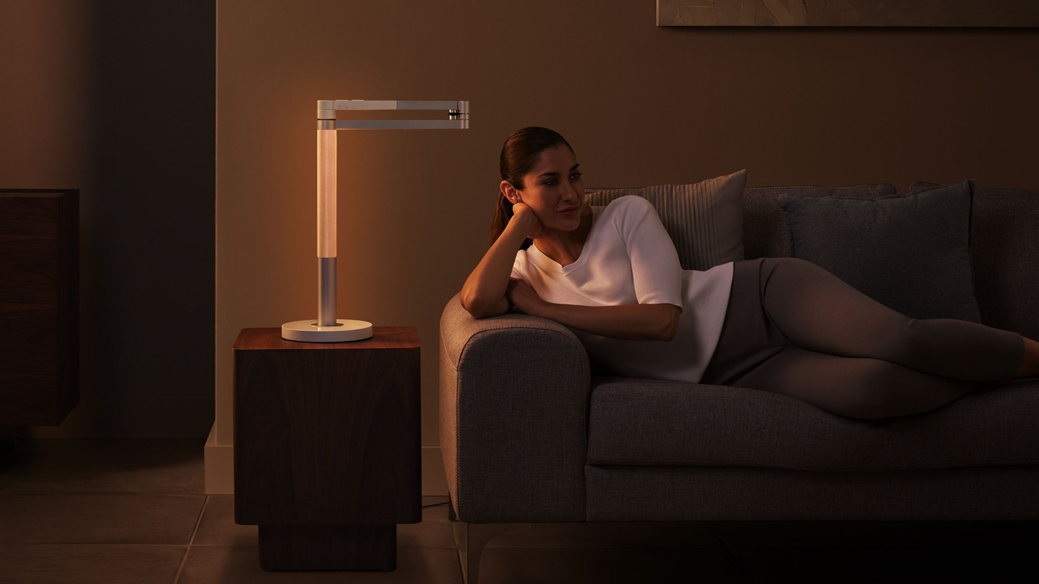
Biomimicry Case: Mimicking the Natural Light Cycle

Slide 10
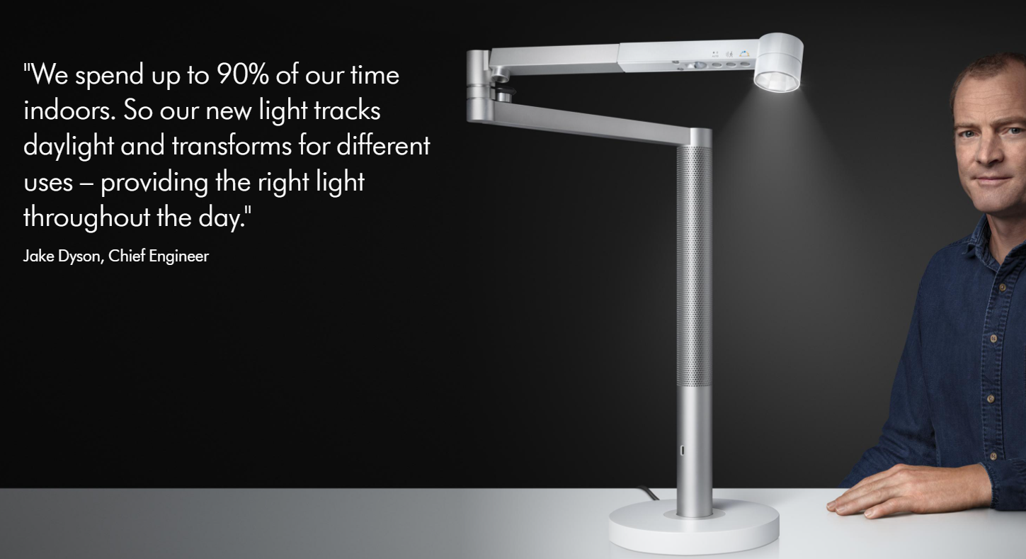
Dyson Solarcycle Light, A task light that adjusts its brightness and color temperature to mimic natural daylight, promoting better well-being.

Slide 11
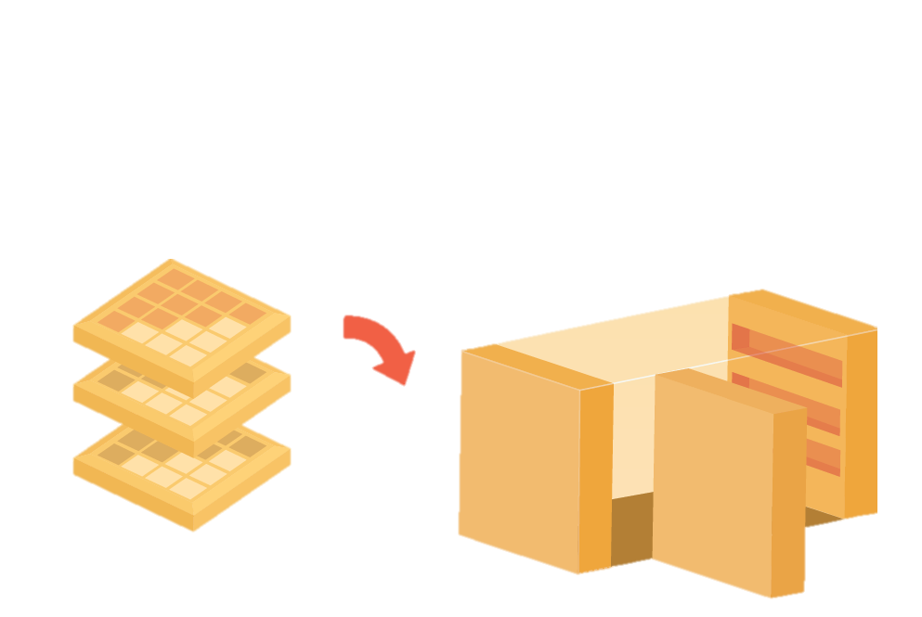
Worked Example 1: Underground Station Lockers
Design Challenge
How might we design a station:
increases productivity and efficiency
enhancing user satisfaction?
Prompt:Waffle
Target: Shelves
Analogy
Metaphor
Proposed solution
Multi-functional shelves inspired by waffles
Can be unlocked and rotated to reveal inner compartments
Inner compartments provide secure storage for sensitive documents
Notes:
The design challenge is to create a station that improves productivity and efficiency while also enhancing the user experience. One solution we explored is multi-functional shelves inspired by waffles. These shelves can be unlocked and rotated, revealing hidden inner compartments. The inner compartments can be used to store sensitive or secure documents, adding functionality without taking up extra space. Overall, this design maximizes space, improves organization, and adds flexibility for the user.

Slide 12
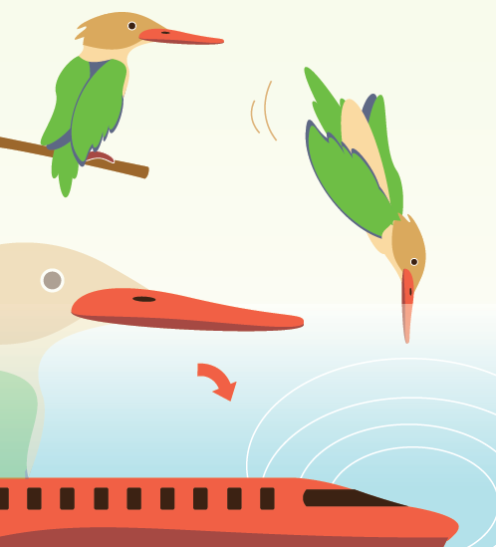
Worked Example 2: Aerodynamic inspiration for Japan’s Train
Prompt: Kingfisher Beak
Target: Train’s Nose shape
Analogy
Metaphor
A train nose could be reshaped, drawing inspiration from how Kingfishers dive at high speed into water without a splash, mimicking the streamline geometry of the kingfisher bill to drastically reduce sonic boom effect
This biomimetic innovation reduced the pressure waves, making the train 10% faster, 15% more energy-efficient, and significantly quieter, demonstrating nature's problem-solving prowess in engineering.

Slide 13
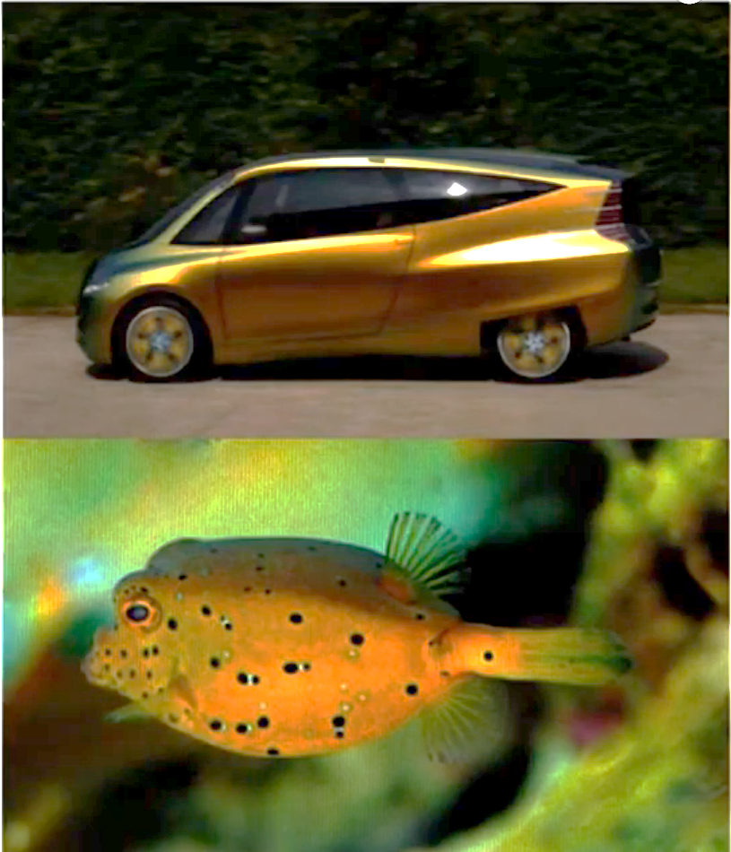
Mercedes-Benz bionic car
.
Prompt: lightweight chassis
Target: fish bone structure
Analogy
Metaphor
Mercedes-Benz modeled a car on the boxfish, combining innovation, functionality, and sustainability in automotive design
Aerodynamic body → reduces air resistance, improves fuel efficiency.
Strong yet lightweight chassis → mimics boxfish exoskeleton.
Honeycomb- inspired structure → increased stiffness by up to 40%, while the weight is reduced by around 30%.
Notes:
“Mercedes-Benz looked to the boxfish, a small fish with a rigid, lightweight, and surprisingly aerodynamic body, as inspiration for a concept car.”
“The idea was to combine innovation, functionality, and sustainability—so the car isn’t just visually unique but also efficient and practical.”
“The aerodynamic body reduces air resistance, which improves fuel efficiency—just like the boxfish moves smoothly through water.”
“The chassis is strong yet lightweight, mimicking the boxfish’s exoskeleton to maintain stability without adding unnecessary weight.”
“They also used a honeycomb-inspired structure, which increases stiffness by up to 40% while reducing weight by around 30%, showing how nature can guide both form and function in engineering.

Slide 14
Using Nature-Inspired Design
Basic Steps for using this method:
Step1: Start by writing down your design challenge e.g., “How might we design a leather good that protects contents and is easy to use
Step 2: Identify the function that your product or service is trying to solve. Just write down the function, don’t try to solve it quite yet (e.g.: “My product needs to keep people warm”)
Step 3: Take one function and brainstorm all the ways that nature might solve this problem. Try to brainstorm as many ideas as you can think of (in the case of protecting a leather bag’s contents, you might say things like, “Tough shells to shield seeds,” “Flexible joints in animals for movement,” or “Water-repellent leaves to keep moisture out”). You can use Ask Nature as a resource for this.
Step 4: When you feel like you’ve come up with an exhaustive list, take one example and see if you can use it to create guidelines for your own product or service. (Keeping with the packaging example, you might list things like, “The packaging biodegrades after use” or “The packaging is highly durable,” etc.)

Slide 15
Lessons from Biomimicry Examples
Nature inspires function and form → e.g., boxfish shapes for aerodynamics, waffle patterns for flexible storage.
Efficiency and sustainability → natural solutions often maximize performance while minimizing resources.
Multi-functionality → structures in nature serve multiple purposes, like rotating shelves or honeycomb chassis.
Innovation through observation → looking at natural systems sparks creative, practical solutions.
Guidelines for your design → define challenge → identify function → explore nature → translate into product features.
Notes:
From our worked examples, we can draw some key lessons about biomimicry in design. First, nature inspires both function and form—for instance, the boxfish influenced the car’s aerodynamic shape, while the waffle pattern inspired flexible, multi-functional shelves.
Second, natural solutions often optimize efficiency and sustainability, maximizing performance while using minimal resources.
Third, multi-functionality is common in nature—structures often serve multiple purposes, like the rotating shelves or the honeycomb chassis in the car.
Fourth, observing natural systems fosters innovation by sparking creative and practical solutions.
Finally, these insights give us a clear guideline for design: start by defining the challenge, identify the function, explore nature for inspiration, and then translate those ideas into concrete product features.”

Slide 16
Useful links and Resources
Word Tree – www.wordvis.com
Provides a visual network of related words, prompted by a single keyword of the design/engineer’s choice.
AskNature – www.asknature.org
A biomimicry database that inspires design through biological phenomena.
Copying nature helps – https://www.youtube.com/watch
Nature inspired solututions
How a kingfisher helped reshape Japan's bullet train
Japan’s Shinkansen Train Example - https://www.bbc.com/news
Biomimicry application examples
https://biomimicry.net/work-examples

Slide 17
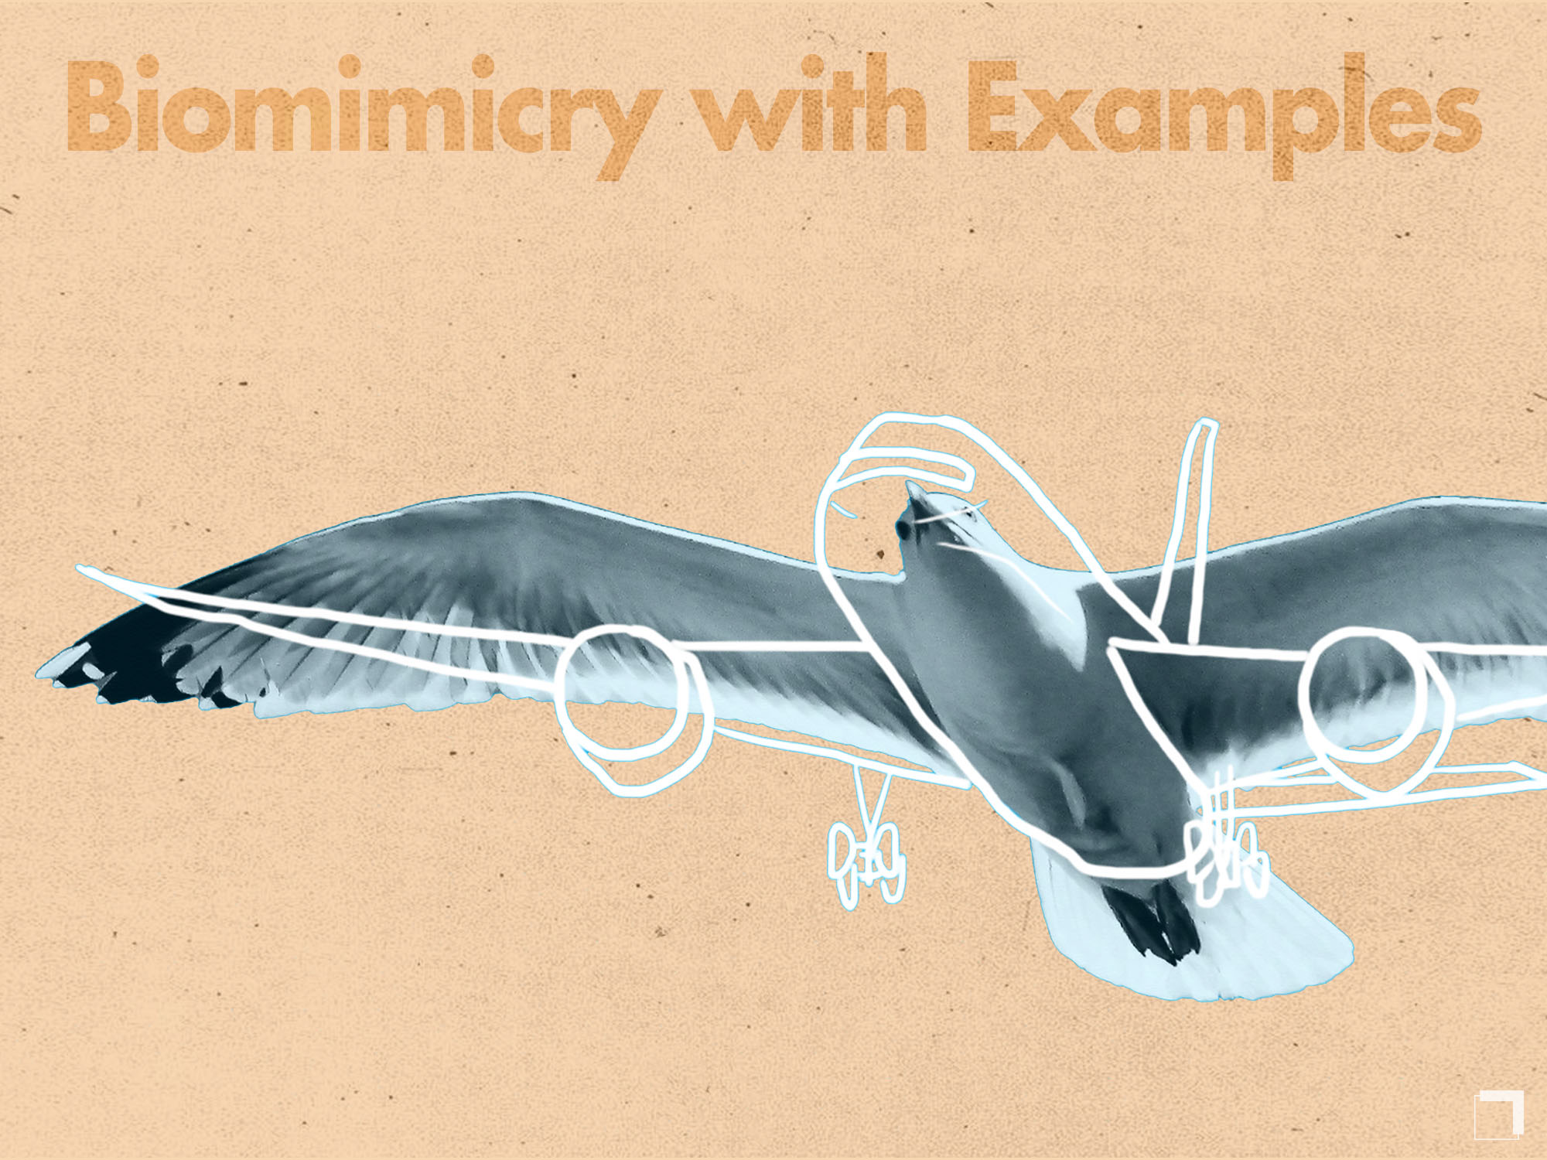

Slide 18
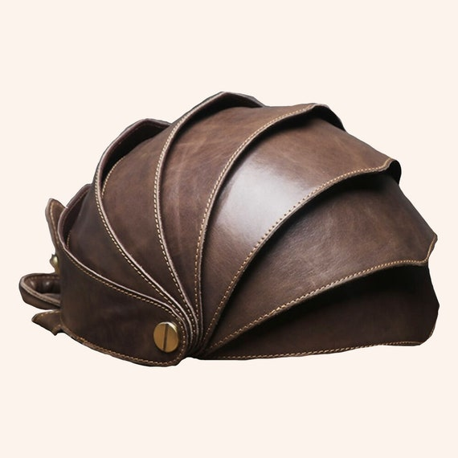
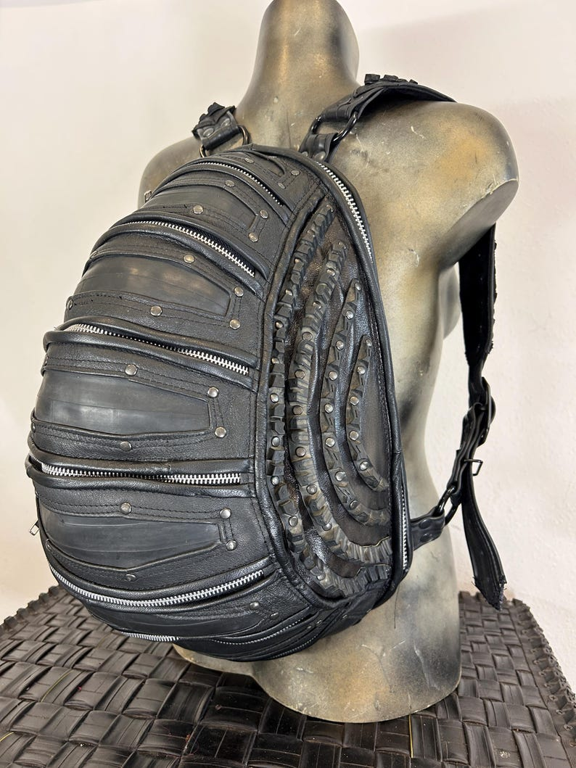
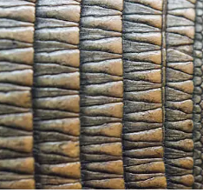
Case Study: Armadillo Shell
Problem:
  Products often need both strong protection and flexible movement (e.g., luggage, footwear, wearable accessories).
Nature Inspiration:
  The armadillo’s segmented shell protects the body while remaining flexible for movement.
Design Translation:
  Use rigid protective panels connected with flexible joints or seams.
  Hard segments shield the structure from impact.
  Flexible connections allow bending and adaptability to movement or pressure.
Notes:
Here, the armadillo shell shows how nature uses segmentation to balance flexibility and protection. Designers mimic this by using rigid plates connected with soft joints, which we can see applied in modular bags, protective footwear, and luggage that adapts to movement.

Slide 19
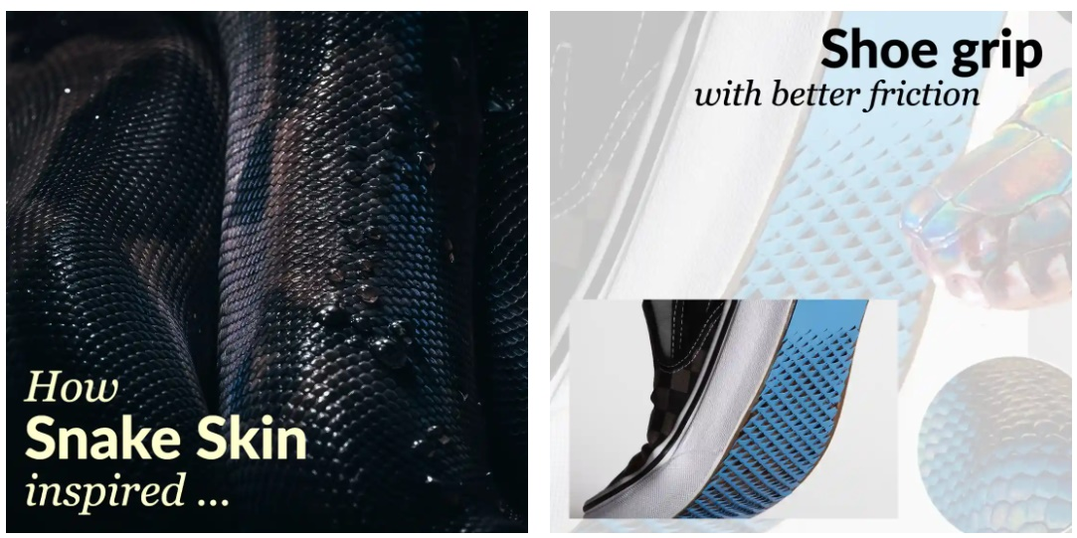
Case study: Snake Skin-Inspired Shoe Grip
Problem:
  Falls are a major cause of injury — better traction can prevent accidents.
Nature Inspiration:
  Snakeskin scales flex to enhance grip during movement.
Design Translation:
  Shoe sole material is cut to mimic scale patterns.
  When stretched, micro-spikes extend for stronger ground contact.
  When pressure is released, the spikes flatten, making the shoe lighter and smoother.
Notes:
Here, snake skin inspires a dynamic grip system that adapts to movement, just as scales adjust when a snake travels over different terrains
Falls are the leading cause of death for older adults and the second leading cause of occupational-related deaths. So, it infers that if we could increase the friction between the feet and the floor, we could save lives and billions in medical bills.
An adaptive shoe grip is designed by cutting the material as to mimic the scales on the skin of a snake.
When the material stretches, the spikes pop out, sticking into the ground and when it flattens, spikes fold back, flattening the surface. This allows the shoes to be more grippy and very light.

Slide 20
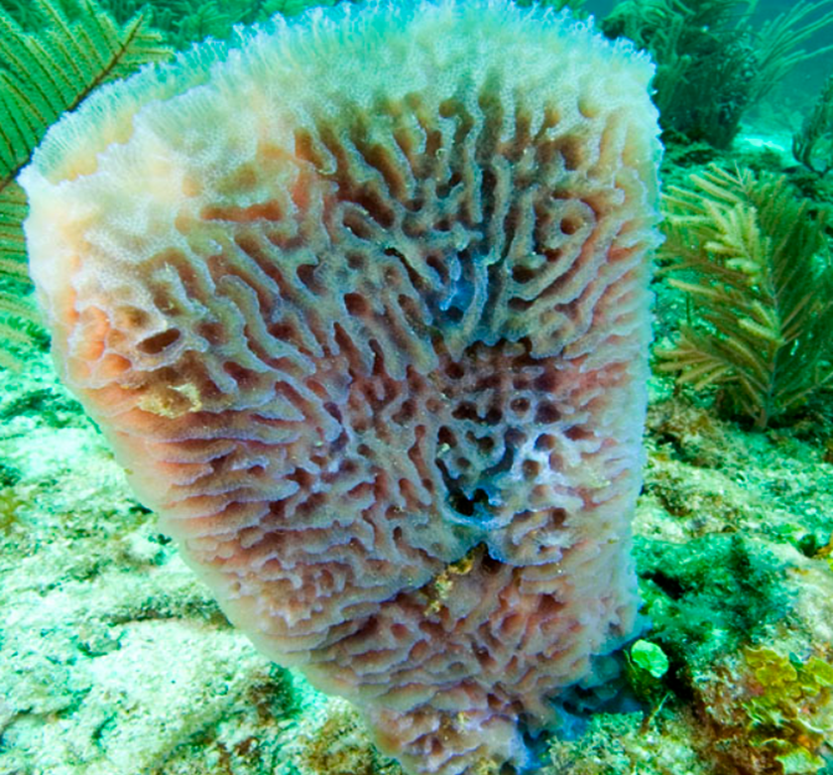
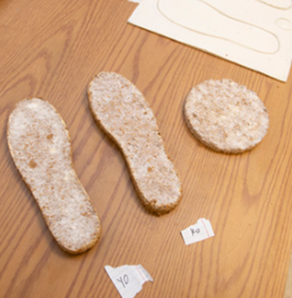
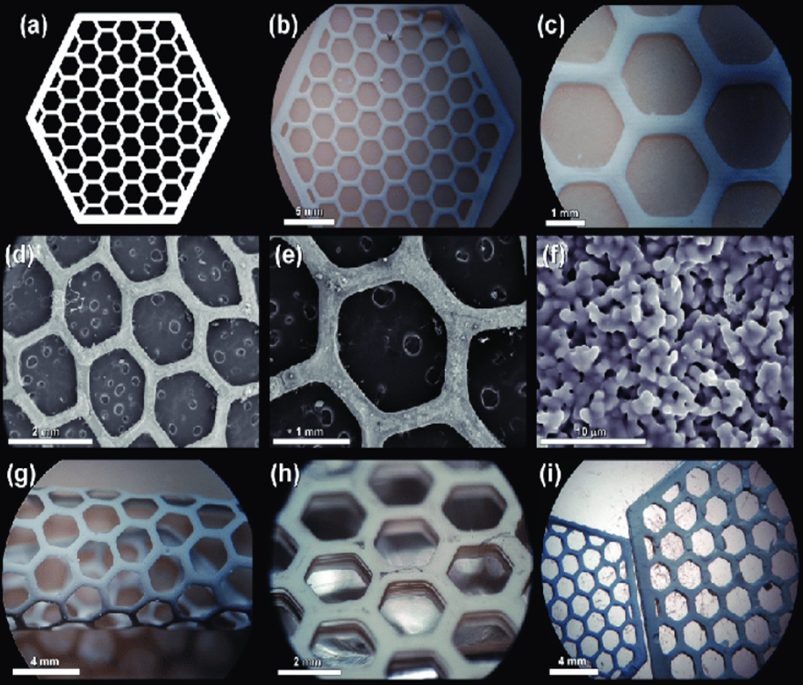
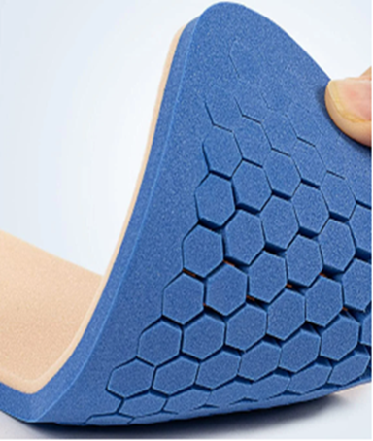
Biomimicry Innovation Examples
Shoe Industry
Sponge structure
Honeycomb structure

Slide 21
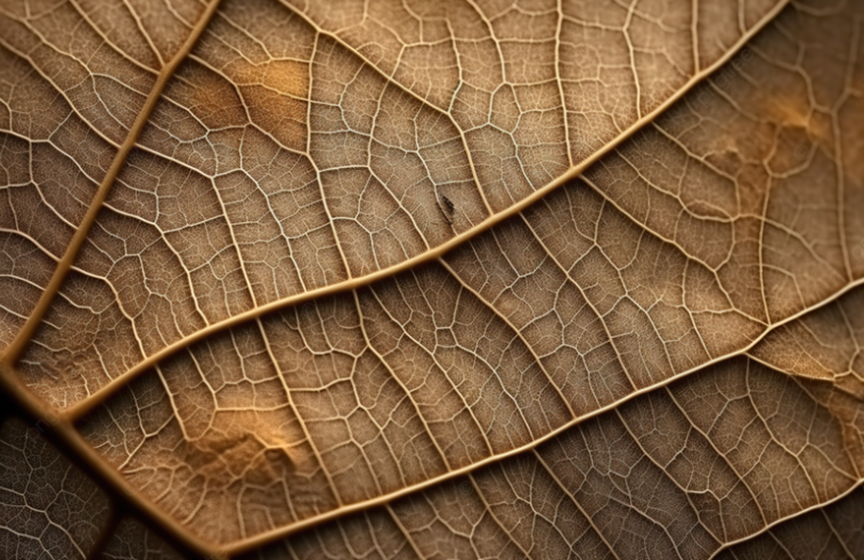
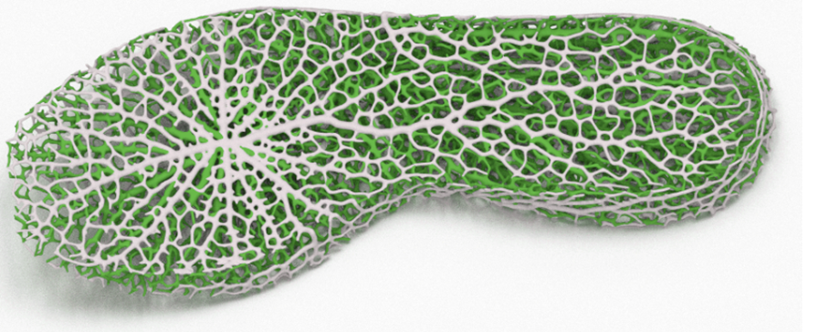
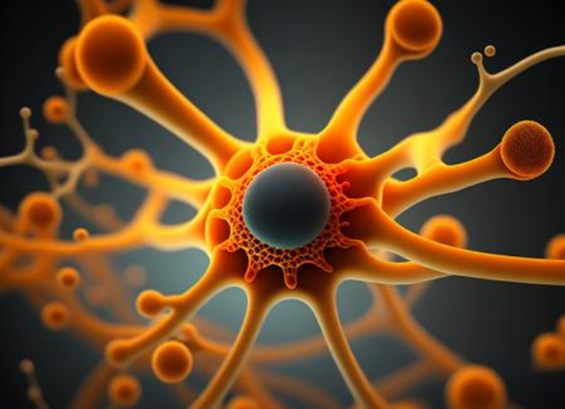
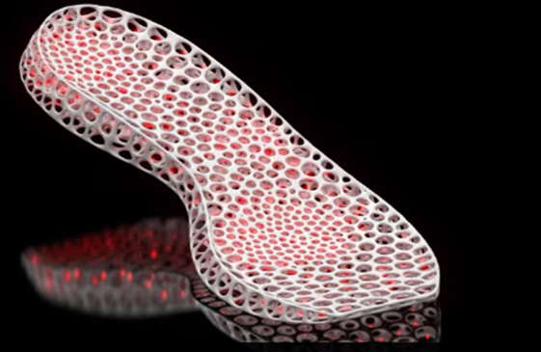
Biomimicry Innovation Examples
Shoe Industry
Leaf's structure
Neural network structure

Slide 22
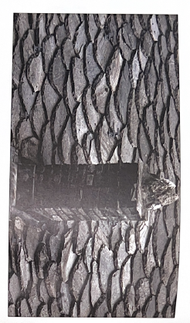
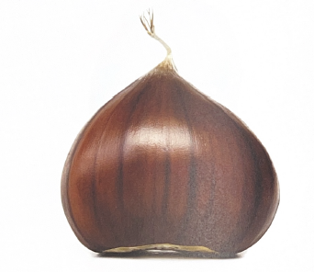
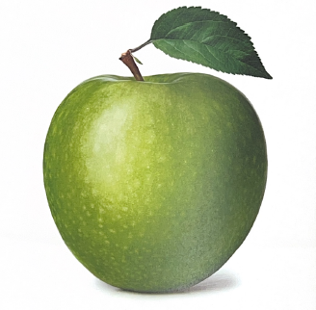
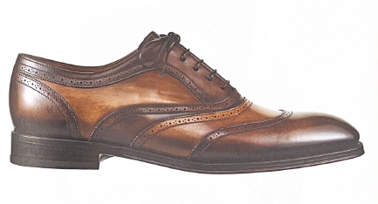
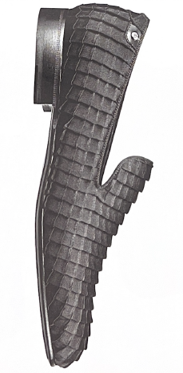
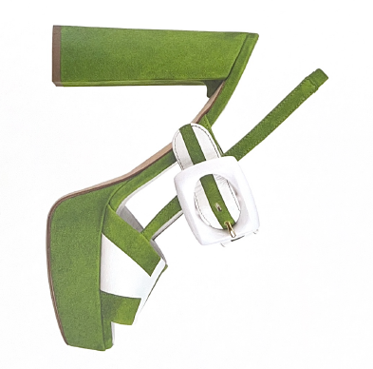
Nature-Inspired Forms & Patterns in Footwear Design
Chestnut or seed pod shape
Roof tile or scale pattern
Chestnut or seed pod shape
From Similitudini: L’arte della calzatura italiana (Gastel & Frigerio, Mondadori Electa, 2017).

Slide 23
Pitfalls of Biomimicry
Superficial copying of shapes – copying how something looks (e.g., shark skin pattern) without applying the functional principle (reducing drag / bacteria).
Ignoring user needs – designs that look clever in theory but fail real users (e.g., footwear that mimics animal feet but is uncomfortable).
Over-complexity – natural systems can be intricate; over-designing makes manufacturing costly or impractical.
Material feasibility issues – biological materials don’t always translate to available technologies (e.g., spider silk vs. synthetic equivalents).
Notes:
“One of the biggest pitfalls is copying nature’s form instead of nature’s principle. For example, just printing a shark skin pattern onto a shoe doesn’t make it antibacterial.”
“Another issue is ignoring the end-user. A biomimicry-inspired concept may look exciting, but if it’s uncomfortable to wear or difficult to use, it fails as a product.”
“Natural systems can also be very complex. Over-designing adds cost and reduces manufacturability. We need to simplify.”
“Finally, feasibility: spider silk is amazing in theory, but producing it at industrial scale is not yet realistic, so designers often have to work with alternatives.”

Slide 24
Designing with Nature –Biomimicry Assignment
Choose a product (sneaker, handbag, accessory)
Identify 1–2 biological inspirations
Develop concept sketches or mock-ups
Explain sustainability + performance benefits
Present as mini design proposal
Notes:
Exercise

